Slide 1
Bloom’s Ball Project

Slide 2
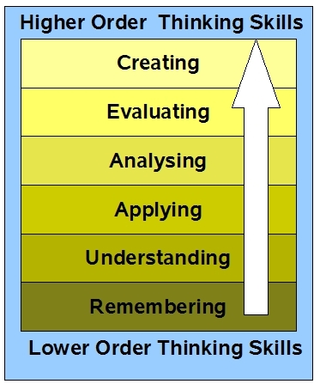
Bloom’s Taxonomy

Slide 3
Directions
Carefully cut out 12 circles using the one you have been given as a template.
Before completing each of the following steps, be certain to observe where the fold lines (the chord lines on the edges of the template circle) are.
Do not write or draw the assignments on the outside of these lines.
You may fold the edges up at this point to remind you not to write in this area.
Do NOT assemble the ball until you have completed writing on all pieces.

Slide 4
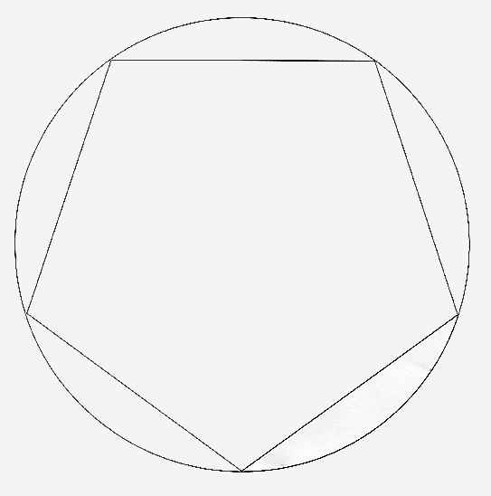
Template

Slide 5
What Goes in the Circles
1. Knowledge: WRITE the title and author of your book in the circle.
Plan the lettering to use up the entire space and make it attractive.
BE SURE TO SPELL EVERYTHING CORRECTLY!
Write the number at the bottom of the circle and be sure to include your name and date on this circle.
2. Knowledge: WRITE four facts about the author of your book (In addition to his/her name)

Slide 6
What Goes in the Circles
Comprehension: DESCRIBE the main character(s) of the story. Include both physical and personality characteristics in your description.
Application: DRAW a picture or a map to represent the setting of the story.

Slide 7
What Goes in the Circles
Analysis: DRAW a picture of the most exciting, the funniest, or the saddest part of the story. Be ready to EXPLAIN why you selected that part.
6., 7., 8. Analysis: On these three circles WRITE a SUMMARY of the book. Include key and important events. Use all three circles.

Slide 8
What Goes in the Circles
Analysis: WRITE a poem about the story. Choose a part of the book that is particularly appealing to you. The poem should be at least two verses. Make it very creative, maybe a shape poem, Haiku or limerick. It can be any type of poem you choose.
10. Analysis: In at least one paragraph write a different ending to the story. (3 complete sentences or more)

Slide 9
What Goes in the Circles
11. Evaluation: WRITE a paragraph telling your opinion of the book. Tell why you would or would not recommend it to a friend. (3 complete sentences or more)
12. Evaluation: DESCRIBE some qualities about one of the characters that you admired or disliked. EXPLAIN why you feel that way.

Slide 10
Directions for Completion
Decorate the edges at this time. Use the theme from the book or make up your own. Your decorations should be on the folded edges only. The edges will be folded up on your finished project.
When all steps have been completed and all the edges are decorated, glue or staple the circles together. Start with one circle and staple to a second circle. On the second circle, staple another circle on the far side of the second circle. Be sure to always skip one space before stapling the new circle. Once you have five circles together, you can close them. Using a sixth circle, staple to the bottom of the five circles. Repeat the above for the remaining 6 circles. Then place one set of circles over the other and staple the edges together.

Slide 11
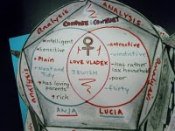
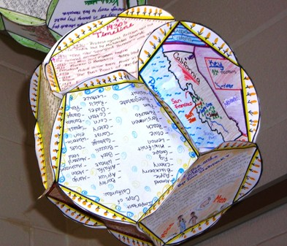
Samples

Slide 12
Final Checklist
Title, Author:
4 Author Facts:
Describe Main Character: (Included both Physical and Personality Characteristics)
Draw a picture or map of the setting:
Picture of most exciting event:
Summary of book:
Include important events:
Complete summary:
Poem about the story:
Different ending (3 or more sentences):
Opinion about book (3 or more sentences):
Qualities Admire or dislike and why:
Decorated the Edges:
Spelling:
Neatness:

